Slide 1

Personal Protective Equipment Maricopa County Office of the Medical Examiner
Prepared by:
Kevin D Horn, MD
Revised by OME Safety Committee 03/2023

Slide 2

Principles of Personal Protective Equipment (PPE) Use
Personal Protective Equipment (PPE) is designed to provide a barrier or shield between you and the chemical or physical hazards that may be present in the workplace
PPE use reduces, but does not completely eliminate, the risk of infection from biohazards in the workplace
PPE is only effective if used correctly
PPE supplements, but does not replace, basic hygiene measures (such as hand washing), good engineering or administrative controls, and good work practices (such as caution with any sharp instruments or objects)

Slide 3
Personal Protective Equipment (PPE)
This training covers the following forms of PPE:
Gloves
Eye Protection
Aprons/gowns
A separate training is available in Workday specific to respiratory PPE: Respiratory Protection Training

Slide 4
Universal Precautions
Any employee in contact with a decedent or blood/body fluids from the decedent will assume the decedent was/is a carrier of a transmissible illness (HIV, hepatitis, TB, etc.)
PPE will be used with any contact with the decedent
Amount of PPE used depends upon degree of exposure (gloves for basic handling of decedent, up to full PPE use during full autopsy)

Slide 5
Biohazards at the OME
Splashes of blood/body fluids
Gown, eye protection, gloves, head/foot covers
Sharp force injury (needlesticks, cuts)
Layering of gloves/cut resistant gloves
Aerosols (blood/body fluids/bone dust from saws)
Respiratory protection (N95 respirators)

Slide 6
Infection risks
Bloodborne (splash or sharps injuries)
Hepatitis B and C
Hepatitis B vaccines required for all employees
Studies indicate about a 1.8 % transmission in needlestick injuries from a known Hepatitis C carrier
Human immunodeficiency virus (HIV)
Airborne (inhalation of aerosols)
Tuberculosis
Hardy organism, may be detected on morgue surfaces and grown in culture weeks following a TB autopsy
Bacterial meningitis
Viral diseases (encephalitis, hantavirus, SARS)

Slide 7
PPE Uses
PPE are used for the prevention of:
Personal infection or injury arising from contamination by blood or body fluid of hair, eyes, clothing, or skin
Transmission of these infectious agents to others in the workplace by the contaminated worker

Slide 8
PPE Types and Uses: Gloves
Should be worn:
Before all contact with bodies, contaminated clothing or effects of the bodies, or contaminated or potentially contaminated surfaces within the autopsy suite
Before and during all cleaning of equipment, tables, and other examination areas

Slide 9
Glove Use
Should be inspected prior to use for holes or defects; check expiration date
Multiple layers (two or more gloves per hand) recommended, as comfort and dexterity allow
Should be changed regularly (between cases)
Should not be washed, stored soiled, or re-used
Should be removed and discarded in proper receptacle prior to entering clean areas.

Slide 10
Proper Glove Removal
With both hands gloved, peel one glove off from top to bottom and hold it in the other gloved hand
With the exposed hand, peel the second glove from the inside, tucking the first glove inside the second; Never touch the outside of the glove with bare skin
Dispose of gloves promptly in biohazard can
Every time you remove gloves, wash your hands with soap and water as soon as possible

Slide 11
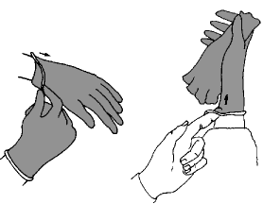
Proper Glove Removal Technique

Slide 12
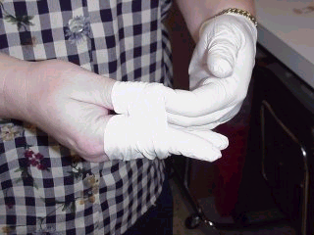
Minimal Contact Between Ungloved Hand and Contaminated Outer Surface of Glove

Slide 13
PPE Types and Uses: Disposable Aprons/Gowns
Disposable aprons/gowns are for use wherever risk of a biohazard splash is present, to protect clothing and underlying skin.
Use of full cover gowns recommended rather than aprons for autopsy examiners and direct observers.

Slide 14
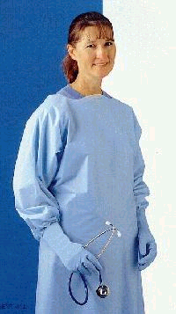
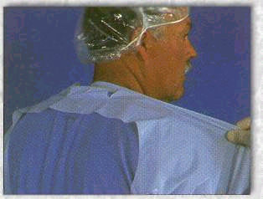
Disposable Gowns: Remove by grasping contaminated front with gloved hand and tearing along perforations at neck.

Slide 15
PPE Types and Uses: Eye Protection
Safety glasses, disposable face shields, and side shields (for use with prescription glasses) available at the OME
Full coverage of the eyes is necessary to protect from splash injuries, either from biohazards or chemicals utilized in the lab
To remove, look down and pull glasses or shield toward floor (away from eyes) to prevent contamination

Slide 16
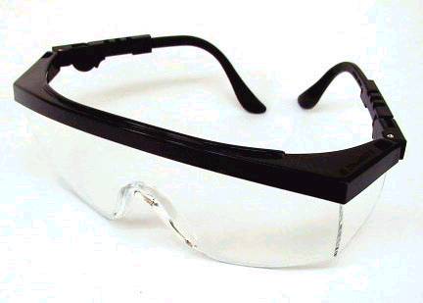
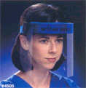
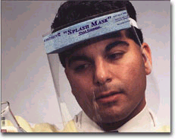
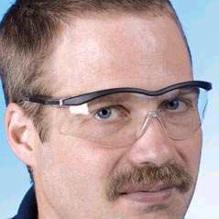

Slide 17
Splash Injuries
Mucocutaneous exposure (eyes, mouth)
Wash the affected area with copious amounts of water
Irrigate the affected eye with copious amounts of saline or water-before and after removal of contact lenses if worn
Eye wash stations and eye wash bottles are available throughout the OME facility and while on scene

Slide 18
PPE at the Scene
Universal Precautions should be observed at all times with any decedent contact
Employees shall utilize the Scene Response PPE Matrix, available in the Safety Manual, as a guide for proper PPE usage based on type of scene.

Slide 19
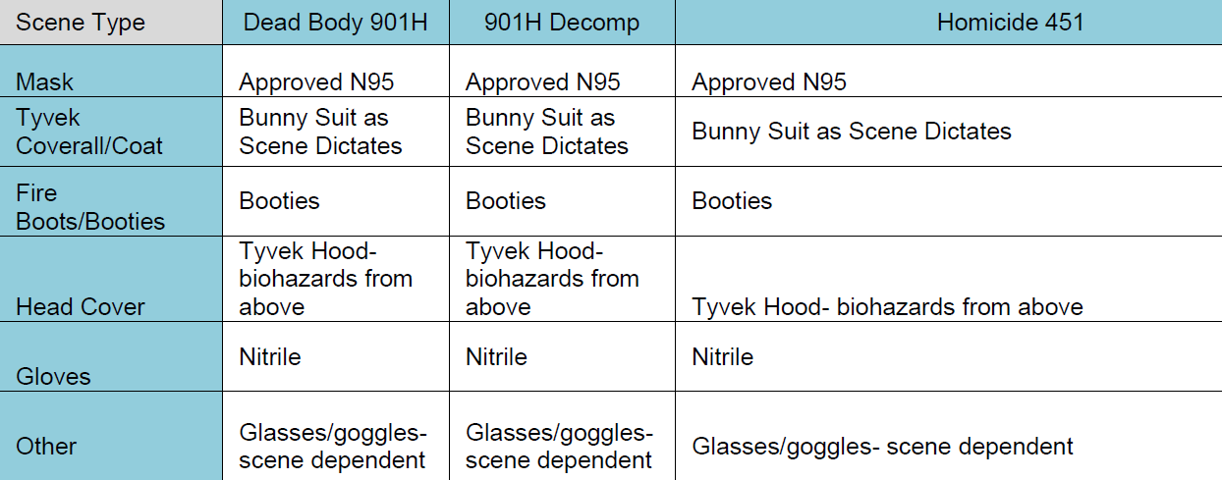
Scene Response PPE Matrix

Slide 20
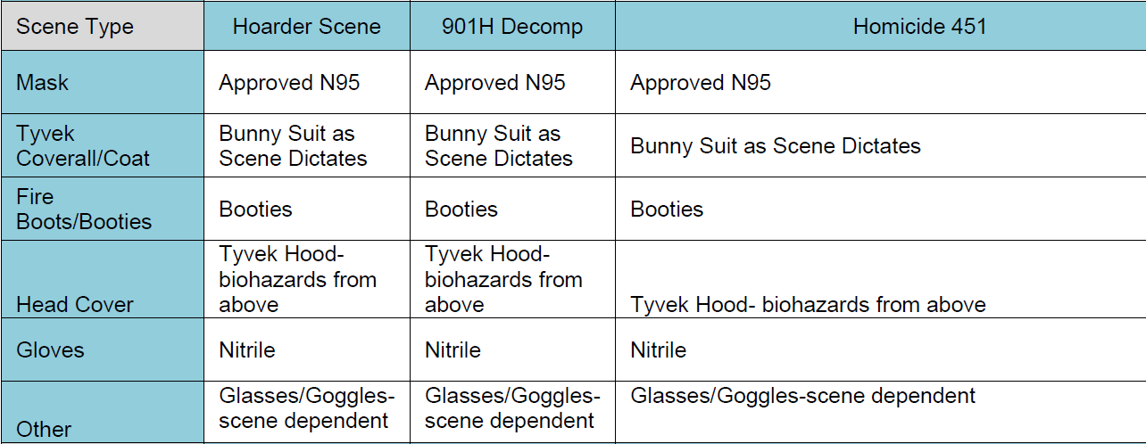
Scene Response PPE Matrix

Slide 21
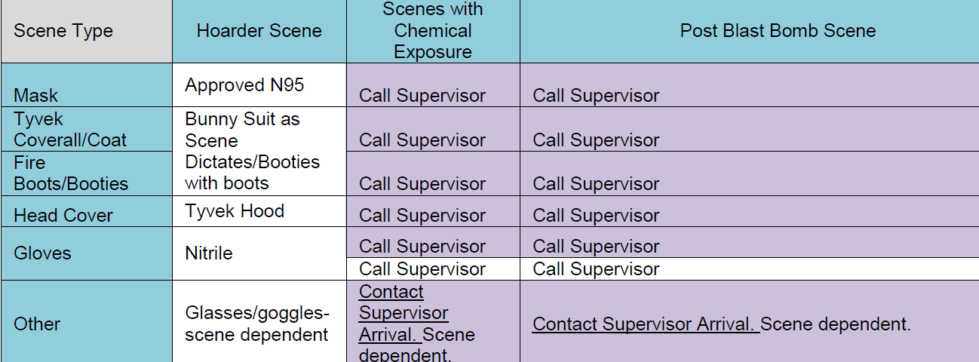
Scene Response PPE Matrix

Slide 22
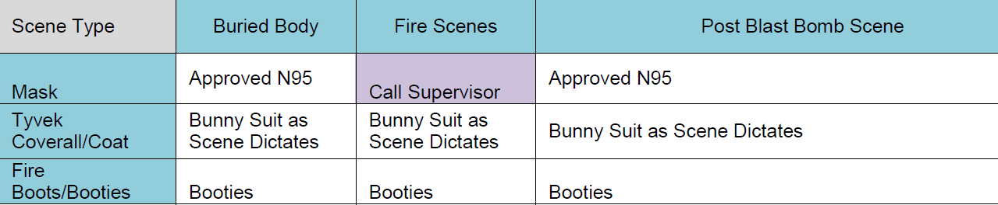
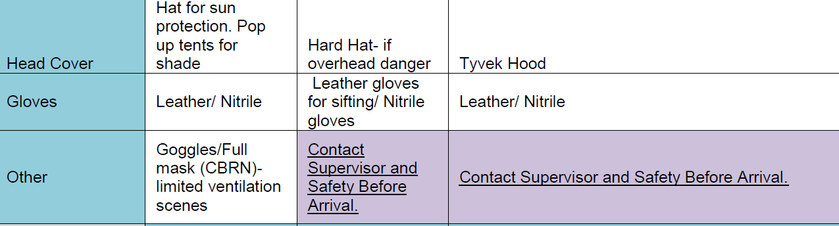
Scene Response PPE Matrix

Slide 23
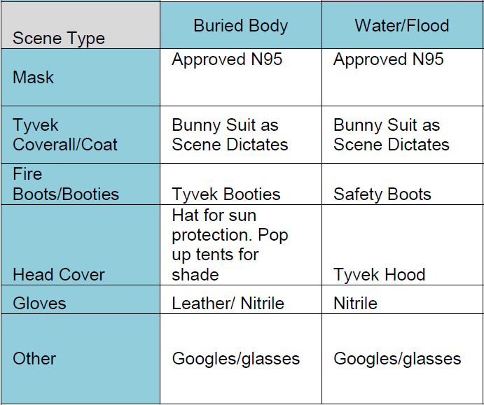
Scene Response PPE Matrix

Slide 24
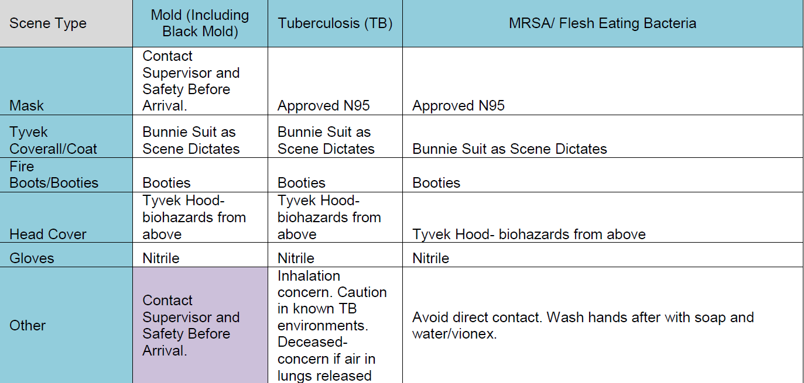
Scene Response PPE Matrix

Slide 25
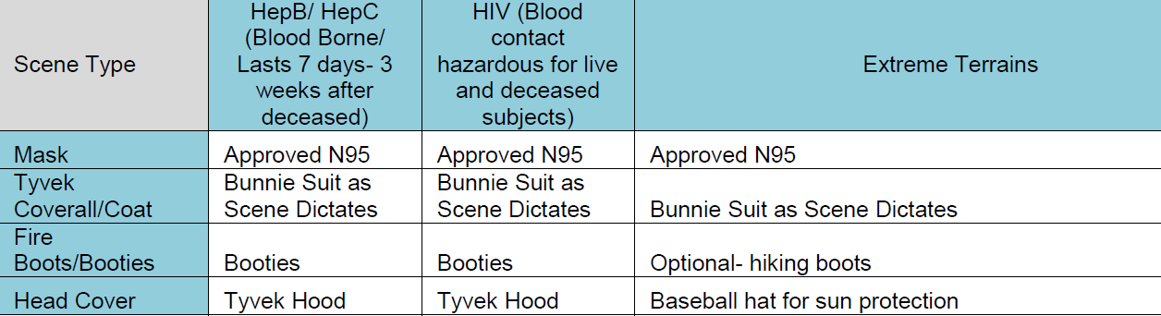
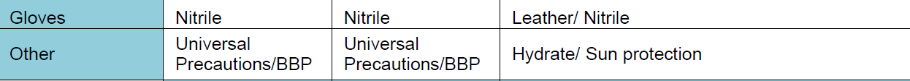
Scene Response PPE Matrix

Slide 26
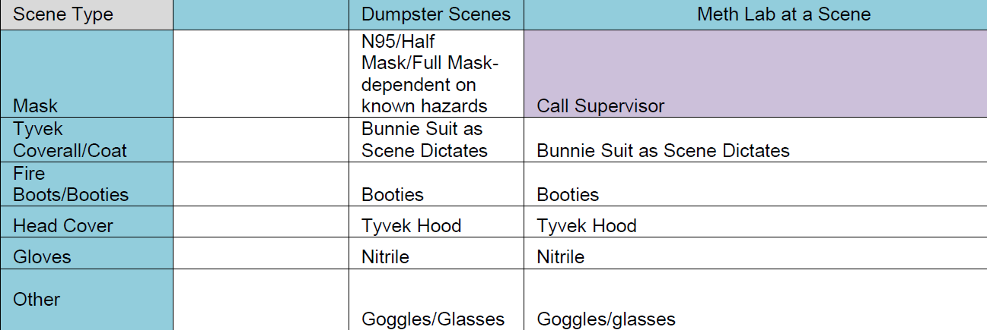
Scene Response PPE Matrix

Slide 27
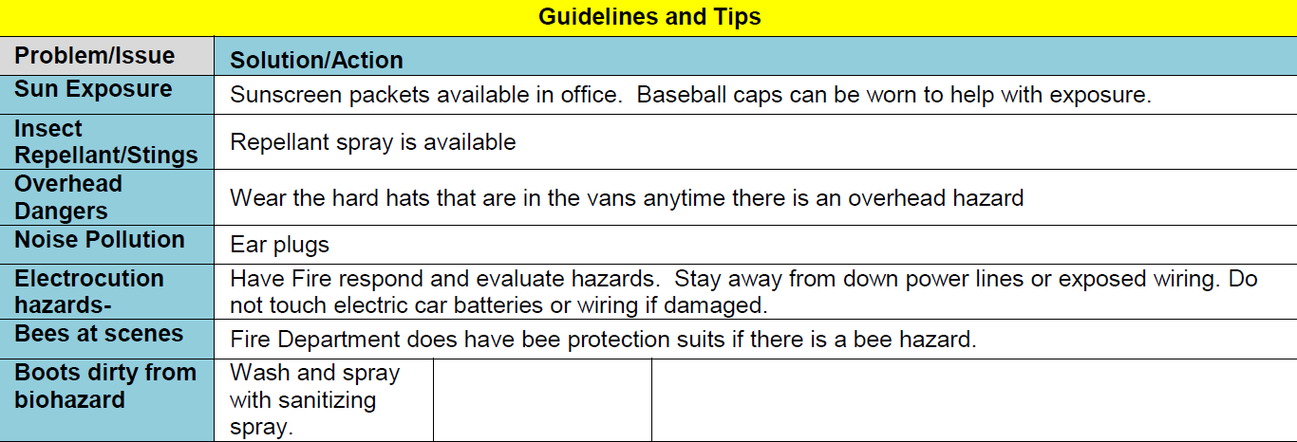
Scene Response PPE Matrix

Slide 28
PPE at the Scene
In cases without decomposition or obvious external fluid leakage, a towel or other covering should be placed over the nose and mouth of the decedent before lifting or turning
Eye protection will be worn in those cases with risk of splash exposure to blood/body fluids
If the employee has any doubts about the scene and appropriate safety precautions, the employee should contact the supervisor on duty

Slide 29
Biohazards - Safety with sharps
Keep a minimum number of sharp instruments in your workspace as is necessary
Never have sharp instruments out of sight or immediate control, especially when contaminated or on contaminated surface
Never recap needles or remove scalpel blades by hand
Discard sharps in labeled puncture resistant containers – do no overfill the bins

Slide 30
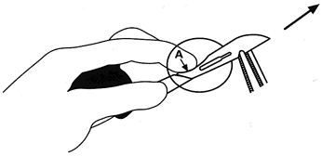
One-hand Technique for Scalpel Blade Removal, Using Forceps
NEVER REMOVE THE BLADE WITH YOUR HAND

Slide 31
Sharps Injuries
Encourage gentle free bleeding of the wound under running water. The wound should not be sucked.
Wash the wound thoroughly under running water using Betadine or Hibiscrub. Do not vigorously scrub or overly traumatize the wound, which can ENCOURAGE penetration of the organism.
Cover the wound with a waterproof dressing.

Slide 32
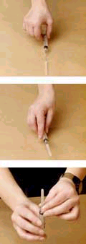
AVOID recapping needles unless necessary
If you recap, use the one-handed “scoop” technique shown here
To remove needle from syringe, use forceps or needle removal slot on biohazard container
DO NOT USE YOUR OTHER HAND
We have re-usable large bore needles at FSC for collection of large volumes of toxicologic specimens
Use forceps or dura remover to safely remove these needles from the syringe and deposit the used needles into metal containers for sterilization and re-use

Slide 33
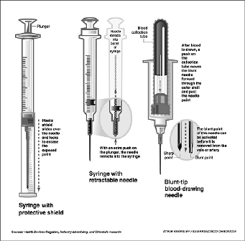
Needle Safety Devices - Examples

Slide 34
Report All Injuries
Notify a supervisor as soon as possible. They will complete an online claim form documenting the report of injury or exposure.
Your supervisor will direct you to the contracted occupational health facility and/or the exposure triage number for the occupational health facility for treatment or monitoring of the injury/exposure.
Documentation of your exposure is critical in order to have a timely record of what occurred in the event worker’s compensation coverage is needed for any future illness which resulted from the exposure

Slide 35
Post-Incident Investigation Reports
The Department Safety Committee will review all reports of injury or exposure to determine if changes are needed to safety protocols or safety training. County Risk Management also offers recommendations.

Slide 36
PPE Maintenance and General Rules
PPE furnished by the OME that is damaged or worn out by use will be replaced.
Employees are responsible for notifying their supervisor when PPE is damaged or worn out by use.
PPE should never be worn in areas where eating and drinking occur.

Slide 37
Conclusions
Full compliance with PPE use is REQUIRED at the OME.
Correct and regular use of PPE is the best way of protecting you from infection and injury in the workplace
Encourage others to follow your example - for their safety and yours!

Slide 38


Slide 39
Thank You

