Slide 1
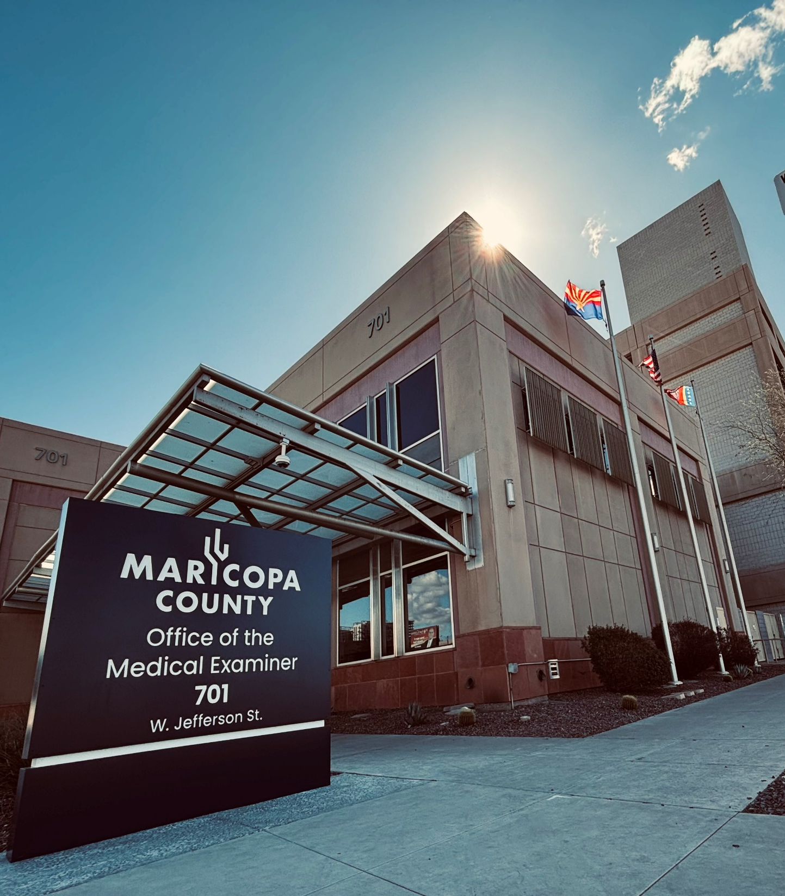

Welcome to the Office of the Medical Examiner
Onboarding Training for the Maricopa County Office of the Medical Examiner (OME) Volunteers & Interns
v.2026

Slide 2
OME History
The Maricopa County Office of the Medical Examiner is the oldest functioning ME office in Arizona.
The first Maricopa County Medical Examiner was named in 1957.
Until 1975, most of Arizona had a coroner system in which the local Justices of the Peace served as the County Coroners.
Currently, the OME is a Medical Examiner system.
The current building was completed in October 2002 and renovated in the summer of 2024.
Dr. Jeffrey Johnston became Chief Medical Examiner of the OME in 2013 and serves as the Director and Appointing Authority of the Department.

Slide 3

Coroner vs. Medical Examiner Systems
Laws governing types of death investigation differ from state to state.
In the US, there is a shortage of trained forensic pathologists.
Coroner System Medical Examiner System
Can be elected or appointed and are not typically required to be doctors
In the event that a coroner is not a medical professional, a decedent may be sent to a medical examiner or pathologist for the autopsy
More common in rural areas
Medical doctors, usually forensic pathologists trained in death investigation
More common in higher population areas

Slide 4

Glossary of Common Acronyms
Coroner/Medical Examiner Database (CME) - CME is the department’s case information management system. The CME database is a system that allows the employees and Medical Examiners involved in a case to enter and review case information electronically. It also allows for reporting and statistical review of cases within our jurisdiction. You will have access to the system via an icon on your desktop and will receive training on its use specific to your job role.
Database Application for Vital Events (DAVE) - DAVE is the Arizona Department of Health Services, Office of Vital Records, Vital Statistics Information Management System. Our admitting section uses this system to initiate the death certificate process. All birth and death events that occur in Arizona are registered through DAVE.
Medical Examiner - May be referred to as ME or Forensic Pathologist
Medicolegal Death Investigator - May be referred to as MDI
Morgue Operations – May be referred to as Morgue Ops or Mops
Forensic Technician – May be referred to as FT
MyMC - MyMC is the County’s internal website and will be the homepage when you open up the internet on your computer. It provides County-wide headlines, resources and information.
Office of the Medical Examiner (OME) - Our department within the County, which is often referred to as the OME
Personal Protective Equipment (PPE) - Often referred to as PPE, this may include protective clothing, gloves, eye protection and other garments or equipment designed to protect the employee from injury or infection.

Slide 5
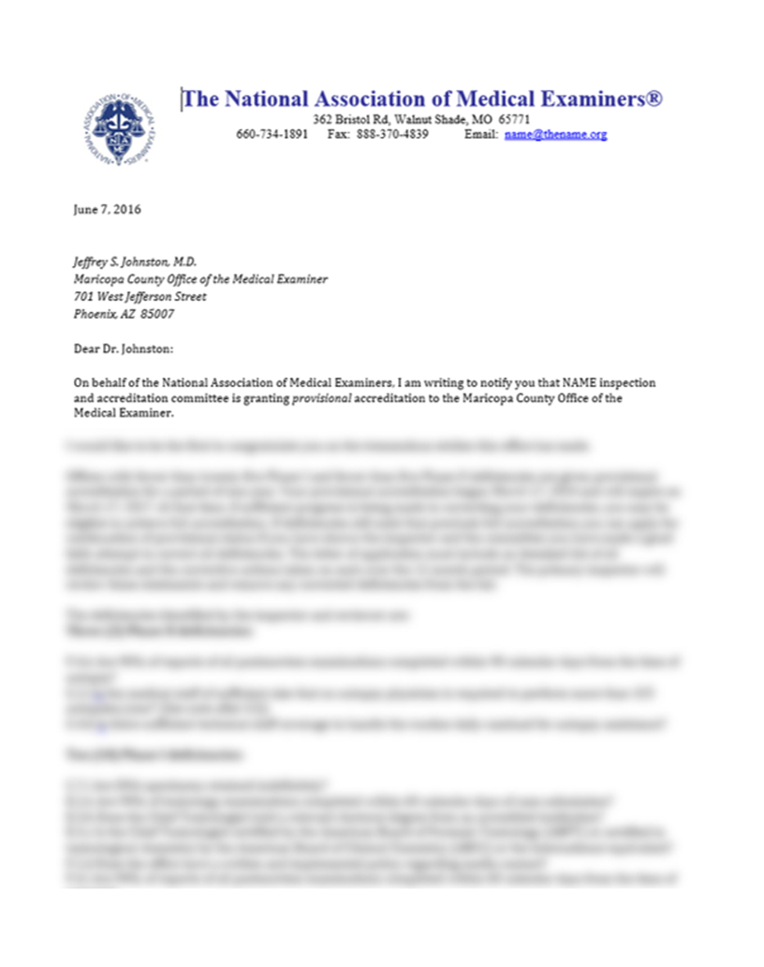
National Association of Medical Examiners (NAME) Accreditation
The OME holds provisional accreditation through NAME for meeting nationally recognized standards for medicolegal death investigations. The office is currently addressing case volume per Medical Examiner in order to achieve full accreditation.

Slide 6
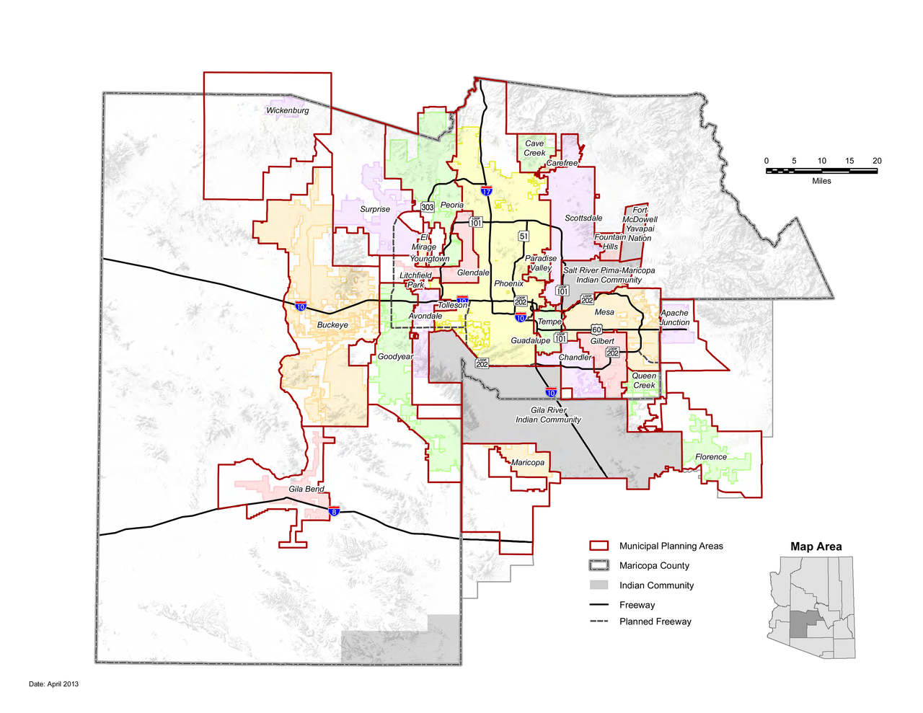
Jurisdiction
The OME serves all of Maricopa County, approximately 9200 square miles. Maricopa County is the 4th largest county by population (approximately 4.3 million) and the 15th largest county by area. The OME interacts with 34 different law enforcement agencies across the county.

Slide 7
Arizona State Statutes
The OME is required by statute to conduct medicolegal death investigations for certain types of deaths (ARS 11-593), including:
Death when not under the current care of a health care provider
Death resulting from violence
Unexpected or unexplained death
Death of a person in a custodial agency
Unexpected or unexplained death of an infant or child
Death occurring in a suspicious, unusual or non-natural manner, including death from an accident believed to be related to the deceased person’s occupation or employment
Death occurring as a result of anesthetic or surgical procedures
Death suspected to be caused by a previously unreported or undiagnosed disease that constitutes a threat to public safety
Death involving unidentifiable bodies

Slide 8
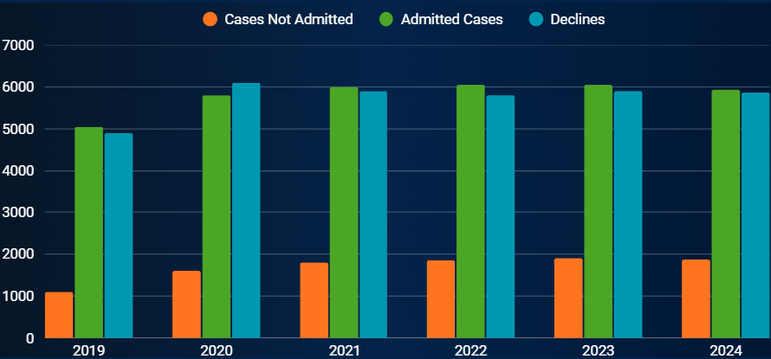
Case Volume by Year
Cases Not Admitted: cases jurisdictionally accepted, but not admitted to the office for physical examination. Death Certificate and report is based primarily on medical records.
Admitted Cases: cases jurisdictionally accepted and brought to the office for physical examination (full autopsy, partial autopsy, or external exam)
Declines: cases reported to the office that are declined based on AZ statutes or jurisdiction

Slide 9
Death Investigation Process
Report of Death
MDI Investigation
Exam
Toxicology and Histology
Report Completion
At the direction of the Medical Examiner, samples are sent for toxicology testing and histology slides are created for ME review
The Investigations section receives the initial report of death, begins the case in the CME system as an inquiry, and a Medicolegal Death Investigator (MDI) begins investigation
Upon receiving the report of death, the MDI begins to document investigative information, dispatch transport, and, as applicable, respond to the scene. The MDI continues to gather medical records and information from next of kin before and after the autopsy is completed until their investigative report is complete.
Within 72 hours, the Medical Examiner performs an autopsy, partial autopsy, or external examination of the body, dictating and documenting findings. The ME signs the death certificate. Following the exam, the ME’s dictated report is transcribed.
Generally, within 3 months, the final Medical Examiner report is completed by the ME and available to stakeholders

Slide 10

Customers and Stakeholders
Next of kin (NOK), family members & their representatives
Friends & associates of the decedent
General public
Law Enforcement
Public Health
Funeral homes
Donor Network of Arizona
Safety Agencies
Health Care Institutions

Slide 11
Examinations
The Office of the Medical Examiner performs external exams, autopsies and partial autopsies seven days a week, excluding holidays when possible.
Each day, a morning meeting is held at 7:00am in the Medical Library. The Medical Examiners scheduled in exams that day will cover relevant case information and plan out the cases for the day with representatives from each section of the OME.
Exams take place in the mornings beginning at 8:00am and are performed by our Medical Examiners, along with Forensic Technicians and Forensic Photographers. Typically, there are 4-6 Medical Examiners each performing 4 or 5 exams a day Mondays through Fridays and 2-3 Medical Examiners each performing 4 or 5 exams on Saturdays and Sundays.
Out of respect for the decedents, volunteers/interns are not able to observe exams without coordinating a tour or educational session through their supervisor.

Slide 12
OME Mission
The Mission of the Medical Examiner is to provide professional medicolegal death investigations of individuals dying under statutorily defined circumstances, the results of which are communicated independently to relevant agencies, industries, and members of the public so they can receive accurate, timely, and effective communications that enhance the public’s safety and health.

Slide 13
OME Vision
To be recognized as a trustworthy source of accurate, scientifically based assessments of deaths in our community by having certified practitioners perform industry-standard professional death investigations, in an industry-accredited organization.

Slide 14
OME Core Values
SERVICE
INTEGRITY
COMPASSION
POSITIVITY
We hold service to be the highest of values. We commit to effective, positive, ethical, and compassionate service to all members of the public and to one another.
We commit to being professional and courteous in all our interactions, both with the public we serve and with each other. We commit to being honest, ethical, and diligent -- to do our best. We commit to being personally accountable for our words and actions and to help cultivate an organization of integrity by expecting the same of others. We do the right thing, even when no one is watching.
We commit to being empathetic, both to the public we serve and to one another, to be mindful of our speech and actions and how they may affect others. We recognize that honest, kind communication, even in the face of conflict, is an act of compassion.
We recognize that our perspective is critical to our attitude and that realistic assessments do not require negativity. We commit to approaching challenges with a positive attitude.
ADAPTABILITY
TEAMWORK
BOUNDARIES
We recognize that nothing is constant. We commit to seeing the positive in change, that it is an opportunity for improvement.
We recognize the critical importance of other members of our department and of those outside our department with whom we work – we all have a role to play on the team. We commit to cultivating a positive, collaborative, service and solutions-oriented environment by working together.
We recognize that we must speak and act within certain bounds, that in order to be effective as a team we must focus on doing our best in our role on the team. We commit to working diligently within the bounds of our roles, being mindful not to attempt to take on inappropriate roles or to judge or undermine those in other roles.

Slide 15
OME Sections
The Office of the Medical Examiner is our department within Maricopa County. The individual group that your position is part of within the department is considered your section.

Slide 16
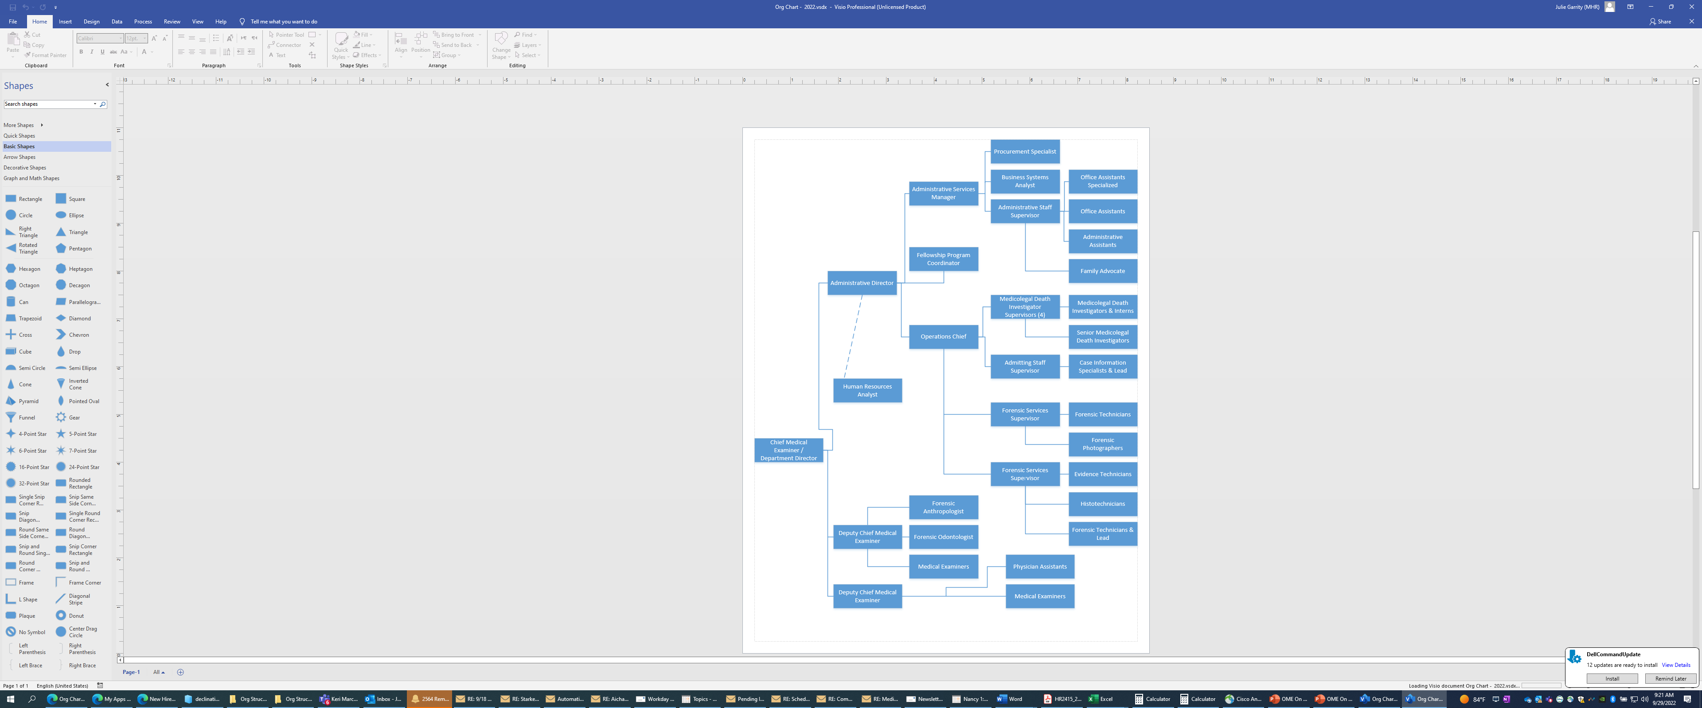
Office of the Medical Examiner
Organizational Chart
Morgue Operations Supervisors
Morgue Operations Assistants & Lead
HR Business Partner

Slide 17

Picture Library
Look for the OME’s Picture Library on SharePoint under the Photography Tab to see who’s who at the OME, including photos and titles of all staff.

Slide 18
OME Sections
Morgue Operations
The Morgue Operations Section is staffed by Morgue Operations Assistants, who coordinate the admission and release of decedents and ensure accurate information is entered into CME on reports of death for investigative follow-up. The Morgue Operations Office is staffed 24/7.
Investigations
The Medicolegal Death Investigators (MDIs), MDI Trainer and MDI Supervisors in our Investigations section are responsible for obtaining information and evidence pertinent to the pathologist’s examination, both at the scene and through follow-up contact with family, medical and law enforcement personnel. Investigations is staffed 24/7. All of our MDIs are required to be certified by the American Board of Medicolegal Death Investigators (ABMDI) by 18 months post hire.
The Identification Coordinator works closely with stakeholders to provide resources, handle escalated concerns, and work on unidentified cases.
Examinations
The Forensic Technicians assist the MEs in conducting postmortem examinations, take radiographs, and maintain the morgue.
Photography
The Forensic Photographers capture digital images during the postmortem examination and provide training to other staff who use photography.
Laboratory
The Laboratory is staffed with Accessioning Technicians and Histotechnicians who assist with the storage and handling of specimens and coordinate offsite toxicology testing.

Slide 19
OME Sections
Medical Staff
The OME has 19 board certified or eligible Medical Examiners who are responsible for the medicolegal death investigations of Maricopa County by conducting autopsies, writing comprehensive reports, and, at times, testifying in court on findings.
The OME also has two Forensic Specialists, including our Forensic Anthropologist, who is responsible for specialized skeletal examinations, and our Forensic Odontologist, who is responsible for specialized dental examinations. Both roles assist Medical Examiners in the death investigation and identification process.
Laboratory
This section encompasses our Histotechnician and Accessioning Technician roles who are responsible for sending out samples for toxicology testing on various specimens and producing slides/stains for the Medical Examiner to read.
Administration and Support
These sections include our Administrative Director, Administrative Services Manager, Business Systems Analyst, Fellowship Program Coordinator, Procurement Specialist, and Front Office Staff who are responsible for the business operations of the department including managing finances, records, and customer services. The Family Advocate is a point of contact for families that handles escalated concerns and provides various grief resources.

Slide 20
Navigating the Office of the Medical Examiner

Slide 21
OME Staff Facilities
Breakrooms
In addition to the breakrooms, employees are welcome to eat outside in the main courtyard or in the outdoor patio area to the east of the building.
Restrooms
Restrooms are located on each floor of the facility. There is one restroom to the left of the lobby entrance, one near the Forensic Technician offices, one in the basement near the rear Morgue Operations offices, and one upstairs by the Lab.
The OME has three employee breakrooms, one on each floor. Each breakroom has a refrigerator, microwaves and a coffee maker.
There are also restrooms in the Investigations area in the building on the other side of the parking garage.

Slide 22
Facility Policies
The OME is a closed facility. Any requests to access the building, including visits from family and tours, must be approved through an employee’s direct supervisor, the appointing authority, or a designee.
All approved visitors must sign in through either the Front Desk or Admitting
Once a visitor is provided access and issued a visitor badge, the employee who brings the visitor into the facility is responsible for ensuring that the visitor is accompanied at all times, has access only to approved areas, and that he or she exits and signs out appropriately. Approved areas for visiting family members of employees include the employee’s office or, should the employee not have their own office, a break room or meeting room. The employee is responsible for ensuring that any sensitive and confidential items in their office are not visible to visitors. Visitors under 18 years of age are not permitted access to the basement level of the OME, laboratory, or MDI offices.
Tours and similar educational requests must be logged on SharePoint under the Admin tab and Educational Outreach for review and approval/denial from the leadership team.
Reference the Facility Security Policy and Employee, Office and Visitor Badges Policy under Directives on SharePoint for more information.

Slide 23
Facility Policies
The County is smoke-free and all county facilities, vehicles, and property are no smoking areas. Those employees who wish to smoke on their breaks must be off of County property (on public sidewalks at least 20 feet from an entrance or ventilation system to the building).
Reference county policy A1919 Prohibitions of Smoking and Tobacco Use on County Property on MyMC for more information.
Unauthorized photography of the OME, scenes, or other case related items is prohibited.
The OME offers a lactation room for new mothers. Check with your supervisor or the HR Business Partner for a current location.

Slide 24
Meeting Rooms
The OME has Conference Rooms in the following locations:
Medical Library on 2nd Floor
Large Conference Room on the 1st Floor of the main building behind the FT offices
Large Conference Room near the Investigation employee entrance
Large Conference Training Room located on the rear side of the Investigations area
To schedule meetings in these rooms, utilize Outlook and add the meeting room as a meeting attendee by searching MEDEX and selecting the desired room. This will hold the meeting room during the block of time needed. You will receive an email indicating whether your meeting is accepted or denied if the room is already occupied.

Slide 25
Parking and Commute Options
The OME has secure onsite parking available to staff in the Visitor parking area (left-hand entrance).
Volunteers/interns should park on the basement level or floors 2-5 past the Juror Entrance. The main floor Visitor parking is reserved for doctors and visiting agencies.
When walking to the OME, volunteers/interns may use their badge to enter the main lobby or they can use the side gate to the patio area to the east of the building. The side gate code is 7046.
The parking garage has security services on site from 6am to 7pm daily.
In the event of an emergency or immediate threat, staff may call central security services or 911. Visit MyMC – Services – Security Services for the main phone line and emergency phone line. Central Security Services is available 24 hours a day, 7 days a week
In the event of immediate threat where a phone call is not possible, the office also has two panic buttons, located in admitting and in the front desk area.

Slide 26
Representing the Office of the Medical Examiner

Slide 27
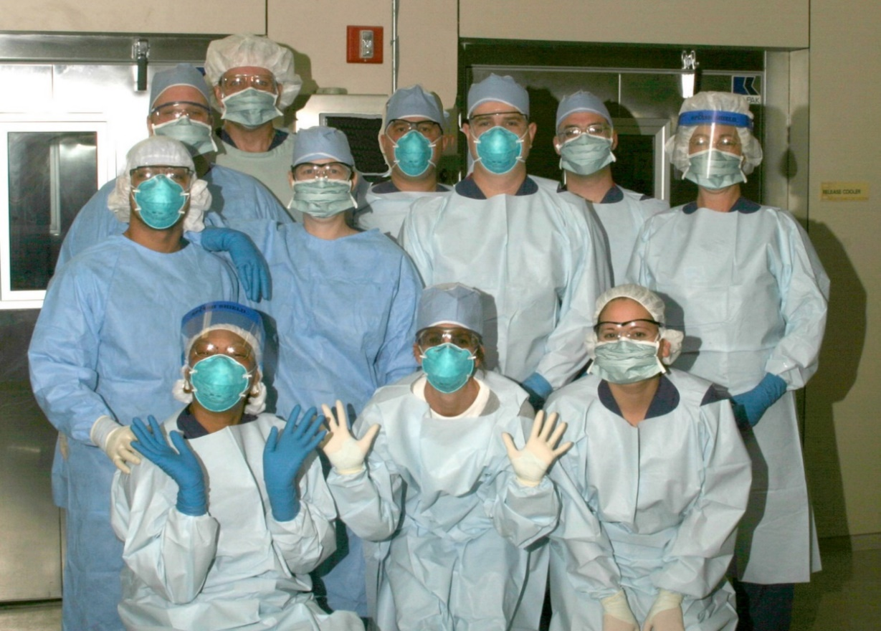
Dress Code
It is important to project a professional image to our community, visitors and other agencies.
Volunteers/interns are expected to adhere to dress standards required for their section. Common sense should be used when choosing clothing, shoes, jewelry, etc. appropriate for your role that adhere to safety guidelines. For guidance on dress in your specific job role, please check the MCOME Volunteer Policy or contact your supervisor.

Slide 28

Email and Telephone Etiquette
Email is one of the most common tools used in business communication.
It is important to provide prompt, professional responses to all emails. Emails should include correct grammar, punctuation and an appropriate subject line.
It’s also a good practice to read through any email before hitting send, to make sure it reads the way you want it to.
Answering a call:
“Office of the Medical Examiner. This is (First Name). How may I help you?” Always end your call with a warm phrase, such as “Thank you for calling.”

Slide 29
Employee Phone Numbers
In the course of work, it may be necessary to reach an employee by calling their cell or home phone numbers. For these reasons, this contact information is stored on SharePoint under the Office of the Medical Examiner tab, Shared Documents “OME Internal Phone List”. Please obtain guidance from your supervisor on contact procedures for personal phone numbers.
Volunteers/interns are not to give out an employee’s personal cell or home phone number under any circumstances. All requests for personal information about an employee should be referred to the HR Business Partner.
The OME Internal Phone List also contains the OME backline number, which can be used in the event staff needs to bypass the phone tree system and reach an OME staff member immediately. This phone number cannot be shared with anyone outside of the OME, including law enforcement, funeral home employees, and other stakeholders.

Slide 30
Professionalism
Professionalism is a set of internalized character strengths and values we exhibit in the workplace. It encompasses many things, including dress, communication style, attitude, sound judgment and respect for others. The professionalism we exhibit as employees of the OME is an integral part of upholding the department’s Core Values and Personnel Policy.
Social Media
Given the nature of the work at the OME, it is important to keep case information confidential and be tactful in referencing anything related to your job via social media. County policy HR2421 states “Employee shall not engage in actions of conduct, including through any form of social media, that could bring disrepute or embarrassment to the County, its departments, agencies, or districts, unless it involves a matter of public concern.” This expectation is the same for volunteers/interns. The department recommends using best judgment when posting on social media, keeping in mind the importance of retaining the trust the Maricopa County community has in the services we provide. For additional information on confidentiality, reference the OME’s Personnel Policy and the County Code of Conduct.
All media requests should be routed to the Public Information Officer for the OME, Mike Molzhon.

Slide 31
Workplace Injuries: You Are Covered
Notify your supervisor immediately of an injury or illness on the job
Contact 911 if injury is life or limb threatening
Non-emergencies go to Banner Occupational Health
You must visit Banner at least once in order for your claim to be valid
Supervisor will complete the incident report

Slide 32
Educational Outreach
We understand you are passionate about our mission, so we want to give you some guidelines for when speaking to the public about our profession and the OME.
Any formal educational outreach presented and facilitated by you, must be approved by OME leadership. This will help us have a standard on how to serve and educate the community.
Employees and Volunteers are not allowed to use OME pictures and or any private case information.
Employees and Volunteers may not use OME or Maricopa County Logo unless presentation is approved by leadership.
Employees and Volunteers may not wear OME unform and or badge during presentation.
Employees and Volunteers must disclose during presentation that they are not speaking on behalf of OME.

Slide 33
Human Resources
The OME has a Human Resources Business Partner on site to answer any questions you may have, help with benefits, and discuss concerns, career plans or any other HR topics. Please stop by the HR Office anytime or, if you prefer, you can schedule a time to meet. You can also contact the HR Business Partner for a variety of other payroll/employment related topics, including needing a new badge or to discuss open positions at the OME.
ETI (Enterprise Technology & Innovation)
The Enterprise Technology & Innovation (ETI) Department assists our staff with any phone, fax, computer or tablet concerns. Submit a ticket on MyMC or call extension 6-HELP to contact ETI for help with technology-related issues. If your issue is not addressed, please notify your supervisor.

Slide 34
Let’s Get Started
Again, welcome to the OME. We are all here as resources to you as you learn about the office and your role.
Please reach out with any questions you may have.
Good luck!

